Slide 1

Analysis of Engineering and Scientific Data
Semester 1 – 2019
Sabrina Streipert
s.streipert@uq.edu.au

Slide 2
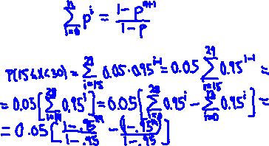
Example (Geometric Distribution):
Suppose you are looking for a job but the market is not very good, so the probability that the person is accepted (after a job interview) is only p = 0.05.
Let X be the number of interviews in which the person is rejected until he eventually finds a job.
1. What is the probability that you need k > 50 interviews?
2. What is the probability that you need at least 15 but less than 30 interviews?

Slide 3
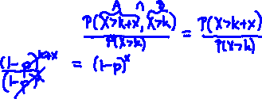
Geometric Distribution — Memoryless Property
Suppose, we have tossed the coin k times without a success (Heads).
What is the probability that we need more than x additional tosses before getting a success?
i.e.,
P(X > k+x | X > k) =
−→

Slide 4
Continuous Distribution I
Uniform Distribution

Slide 5
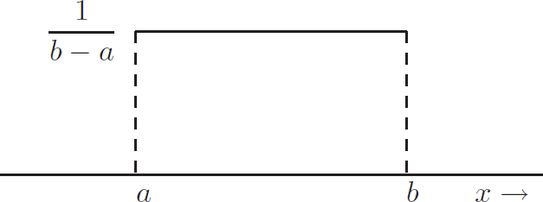
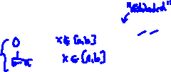
Continuous Distribution I - Uniform
X has a uniform distribution on [a, b], X ∼ U[a, b], if its pdf f is given by
f (x ) =
For example used when modelling a randomly chosen point from the interval [a, b], where each choice is equally likely.
Figure: The pdf of the uniform distribution on [a, b].

Slide 6
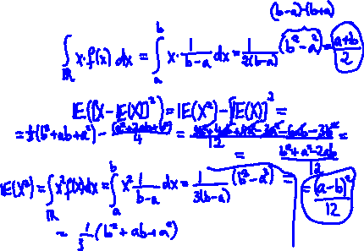
Uniform Distribution - Properties
► E[X ] =
► Var(X ) =

Slide 7
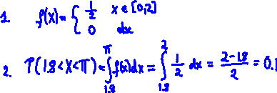
Example (Uniform Distribution):
Draw a random number from the interval of real numbers [0, 2]. Each number is equally possible. Let X represent the number.
Find the probability density function f .
What is the probability that the chosen number is within (1.8, π)?

Slide 8
Continuous Distribution II
Exponential Distribution

Slide 9
Continuous Distribution II - Exponential
X is an exponential distribution with parameter λ > 0,
X ∼ Exp(λ), if the pdf of X is
λe ,
0
x ≥ 0, else
−λx
f (x ) =
∼ continuous version of the geometric distribution. Used for example to analyse:
► Lifetime of an electrical component.
► Time between arrivals of calls at a telephone exchange.
► Time elapsed until a Geiger counter registers a radio-active particle.

Slide 10
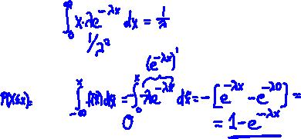
Exponential Distribution - Properties
► E[X ] =
► Var(X ) =
► The cdf of X is given by:
F (x ) =
x ≥ 0, else F (x ) = .

Slide 11
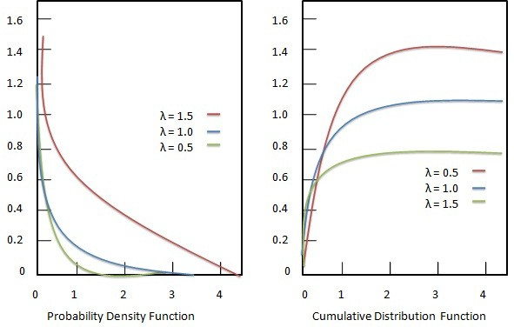
Visualization
Source: https://www.tutorialspoint.com/statistics

Slide 12
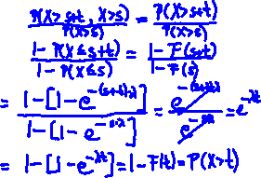
Exponential Distribution - Memoryless Properties
► The Exponential Distribution is the only continuous distribution that has the memoryless property:
P(X > s + t | X > s) =
=

Slide 13
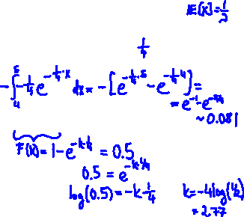
Example (Exponential Distribution):
The time a postal clerk spends with customers is exponentially distributed with the average time of 4 minutes. What is the probability that the clerk spends four to five minutes with a customer?
Since the mean is 4 minutes, we know that λ = .
P(4 ≤ X ≤ 5) =
After how many minutes are half of the customers finished? Aim: Find k such that P(X ≤ k) = 0.5.

Slide 14
Continuous Distribution III
Normal Distribution

Slide 15


Continuous Distribution III - Normal
X is normal (or Gaussian) distributed with parameters µ and
σ², X ∼ N(µ, σ²), if the pdf f of X is given by
1
( )
2
f (x ) =
−
1
x−µ
√ e , x ∈ R.
o 2π
2 σ
Special case: Standard Normal Distribution
If µ = 0 and σ = 1 then
f (x ) =

Slide 16
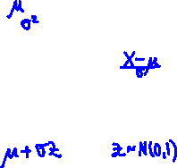
Normal Distribution - Properties
► E[X ] =
► Var(X ) =
► If X ∼ N(µ, σ²), then
∼ N(0, 1).
−→ standardisation
► If X ∼ N(µ, σ²), then
X =

Slide 17
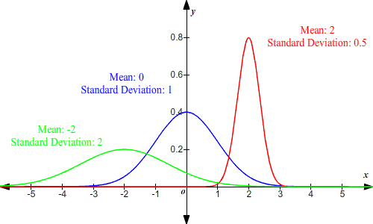
Normal Distribution - Visualization
Source: https://www.varsitytutors.com/hotmath/hotmathhelp/topics/normal-distribution-of-data

Slide 18

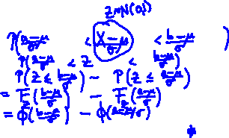
Normal Distribution — Calculation
It is very common to compute P(a < X < b) for X ∼ N(µ, σ²) via standardization as follows.
P(a < X < b) =
=
=
That is,
(
)
( )
b − µ
a − µ
P(a < X < b) = F_{X} (b) − F_{X} (a) = F
Z
− F −
.
σ
Z
σ

Slide 19












Normal Distribution Table
Suppose you want to find the Probability P(X < 5) for X ~ N(3,1.5) using the Normal Distribution Table.
What is P(1<X<5)?

Slide 20
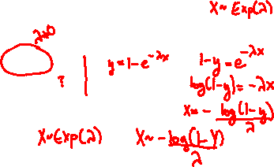
Inverse-Transformation
Exponential R.V. - inverse
For the exponential distribution, we have
F (x ) = 1 − e^{−λx} .
For y ∈ (0, 1),
F⁻¹(y ) =
Hence,

Slide 21
End of Chapter 3/4

Slide 22
Review Chapter 3 & 4
► Random Variables X, Y , Z, . . .
► Probability Mass Function (pmf; p_{i} ) & Probability Density Function (pdf; f )
► Cumulative Distribution Function (cdf; F (x ) = P(X ≤ x ))
► Expectation E[X ] and Variance Var(X )
► Special Discrete Distributions (Bernoulli, Binomial,Geometric)
► Special Continuous Distributions (Uniform, Exponential, Normal)

Slide 23
Chapter 5
Joint Probability Mass/Density Function
Joint Cumulative Distribution Function
Marginal Distributions, Marginal Expected Values
Covariance, Correlation Coefficient
Independence
Conditional pdf/pmf, Conditional cdf, Conditional Expectation
Generalization: Random Vector

Slide 24
Joint Distributions - Motivation
We analyse the student’s weight X and height Y .
Aim: Specify a model for the outcomes?
Note: Can’t just specify the pdf or pmf of one variable,, we also need to specify the interaction between weight and height
−→ Need to specify the joint distribution of weight and height (in general: all random variables X₁, . . . , X_{n} involved).

Slide 25
Joint Distributions - Example
Example:
In a box are three dice.
► Die 1 is a normal die;
► Die 2 has no 6 face, but instead two 5 faces;
► Die 3 has no 5 face, but instead two 6 faces.
The experiment consists of selecting a die at random, followed by a toss with that die.

Slide 26
Joint Distributions - Example
Example:
In a box are three dice.
► Die 1 is a normal die;
► Die 2 has no 6 face, but instead two 5 faces;
► Die 3 has no 5 face, but instead two 6 faces.
The experiment consists of selecting a die at random, followed by a toss with that die.
Let X be the die number that is selected, and let Y be the face value of that die.

Slide 27
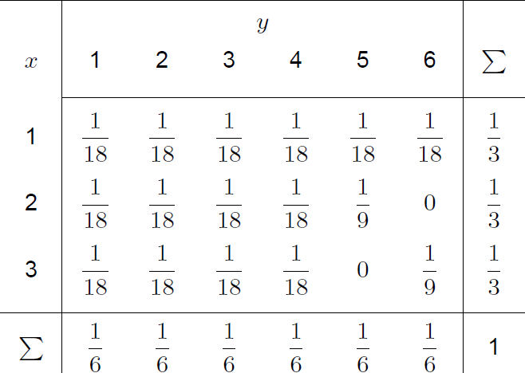
−→
Note:
P(X = x ) =
and
P(Y = y ) =
−→

Slide 28
1. P(X = 2, Y = 4)
2. P(X = 2)
3. P(Y < 5)

Slide 29
Joint Probability Mass Function
Definition
Let (X, Y ) be a random vector. The function
(x, y ) → P(X = x, Y = y ) = P(X = x ∩ Y = y ) is called the
joint probability mass function of X and Y .
Let Ω_{X,Y} be the set of possible outcomes of (X, Y ). Let
B ⊂ Ω_{X,Y} , then
P((X, Y ) ∈ B) =

Slide 30
Joint pmf - Properties
1. P(X = x, Y = y ) , for all x and y .
2. _{x∈ΩX} _{y∈ΩY} P(X = x, Y = y ) = .
Marginal pmf of X :
P_{X} (X = x ) =
Marginal pmf of Y :
P_{Y} (Y = y ) =

Slide 31
Joint Probability Density Function
Definition
We say that random variables X and Y have a joint probability density function f if, for all events
{(X, Y ) ∈ A ⊂ Ω ⊂ R²}, we have
P((X, Y ) ∈ A) =
We often write f_{X,Y} for f .

Slide 32
Joint pdf - Properties
1. f (x, y ) , for all x and y .
2.
∞ ∞
f (x, y ) dx dy = .
Marginal pdf of X :
f_{X} (x ) =
Marginal pdf of Y :
f_{Y} (y ) =
−∞ −∞

Slide 33
Example of a joint pdf:
Bivariate normal distribution:
We say that X and Y have a bi-variate Gaussian (or normal)
2 2
distribution with parameters µ , µ , σ , σ and ρ ∈ [−1, 1] if the
1 2
1 2
joint density function is given by

Slide 34
Example of a joint pdf:
Bivariate normal distribution:
We say that X and Y have a bi-variate Gaussian (or normal)
2 2
distribution with parameters µ , µ , σ , σ and ρ ∈ [−1, 1] if the
1 2
1 2
joint density function is given by
1
(x−µ )
2
(x−µ )(y
−µ ) (y−µ )
2
_{σ}2
1
−2ρ
1 2
+
_{σ}2
2
f (x, y ) = ✓
e
1
σ₁σ₂
2
2πσ₁σ₂ 1 − ρ
2

Slide 35
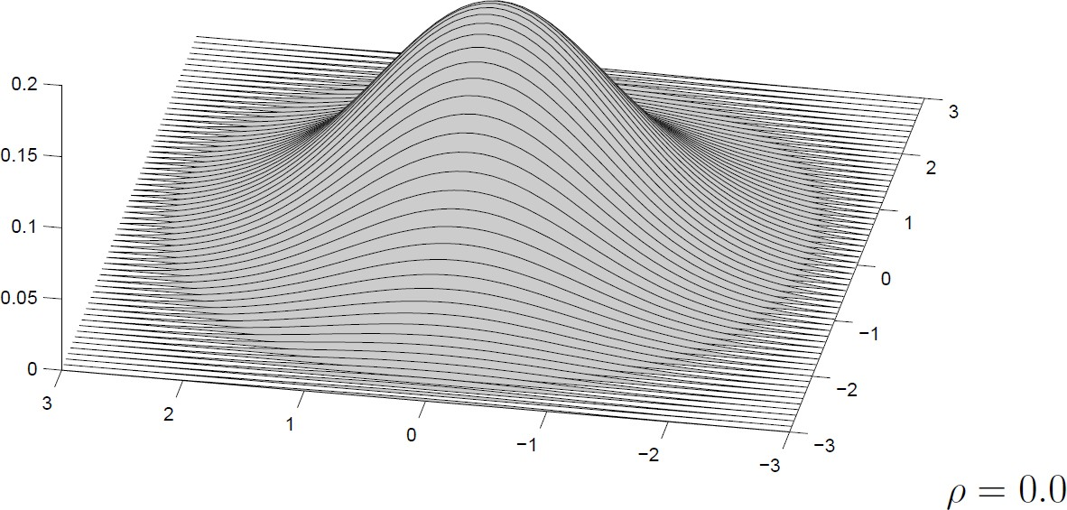
Jointly Gaussian RVs

Slide 36
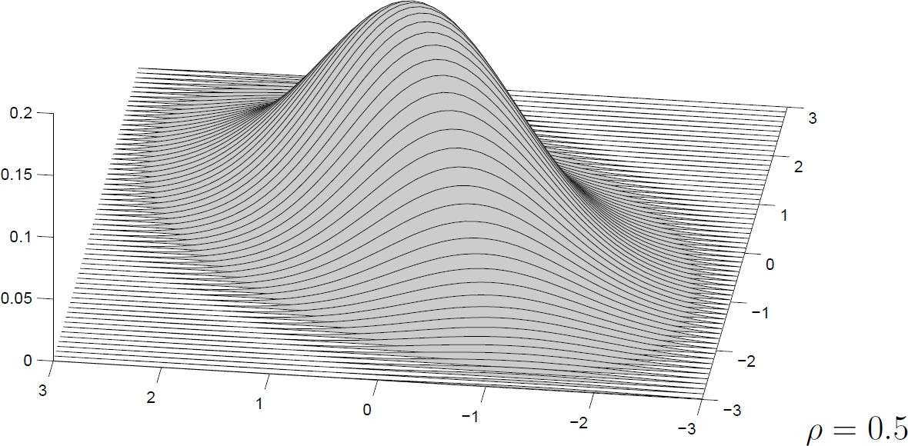
Jointly Gaussian RVs

Slide 37
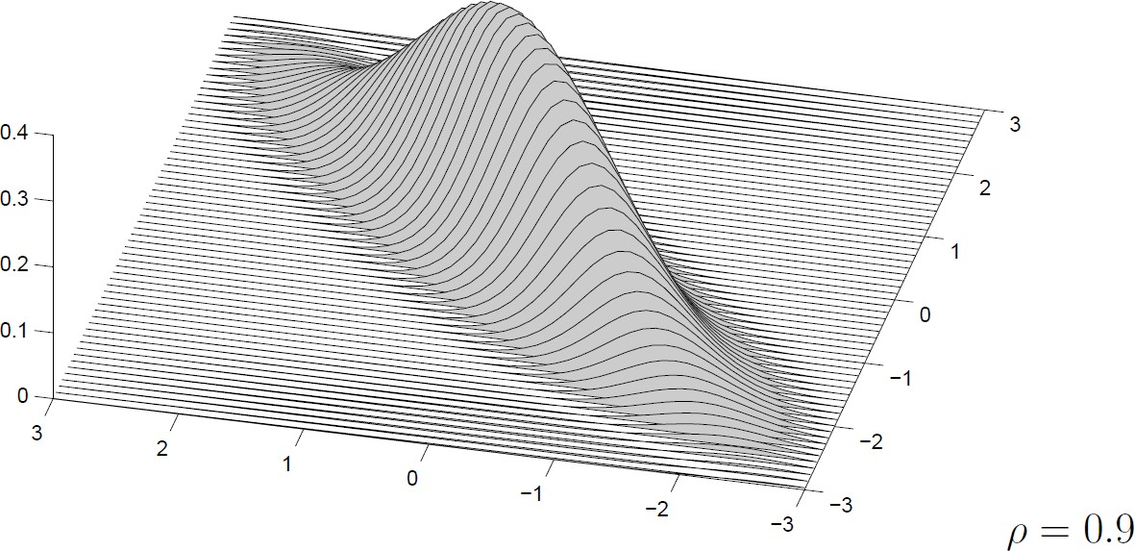
Jointly Gaussian RVs

Slide 38
Joint Cumulative Distribution Function
Joint Cumulative Distribution Function (joint cdf):
F (x, y ) = P(X ≤ x, Y ≤ y )
► If X, Y are discrete R.V., then the joint cdf is
F (x, y ) =
► If X, Y are continuous R.V., then the joint cdf is
F (x, y ) =
Note also:
F (x, y ) = f (x, y ).

Slide 39
Expected value
► If X, Y are discrete R.V., the marginal expected value is:
E [X ] = ,
where P_{X} (X = x ) is the marginal pmf of X .
► If X, Y are continuous R.V., the marginal expected value is:
E [X ] = ,
where f_{X} (x ) is the marginal pdf of X .
► Linearity:
E[aX +bY ] =

Slide 40
Example - revisited
Joint pmf: P(X ≤ 2, Y < 5) =
Marginal expected value:
E (X ) =
Marginal expected value:
E (Y ) =

